Slide 1
CS 242 - CS252 Data Structures
Linked lists – Part 2

Slide 2
Singly Linked List ADT-Extra operation
Search List
Traverse List
Retrieve Node
Destroy List

Slide 3
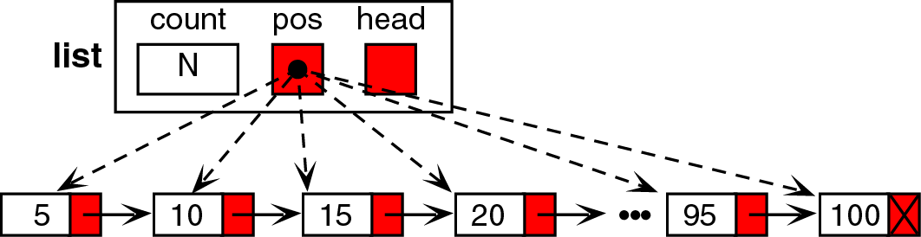
Singly Linked List ADT-Extra operation
Search List
Locating specific data in a list.
In linked list we use sequential search.
We need a key field for search operation.
Traverse List
Start with the head and access each node until you reach null.
Do not change the head reference.

Slide 4
Singly Linked List ADT-Extra operation
Retrieve Element
By using search method.
Destroy List
Deletes all nodes still in the list.
It then sets the metadata to a null list condition

Slide 5
Singly Linked List ADT: Extra methods
Traverse the list by Curr reference (helper methods)
next(): change Curr position to the next node.
moveToStart(): change Curr position to the first of list.
moveToEnd(): change Curr position to the end of list.
moveToPos(pos): move Curr to specific position(pos)
CurrPos(): return the position (index) of Curr.
getValue(): return the element of Curr reference.

Slide 6
Singly linked list implementation: helper methods

Slide 7
Singly linked list implementation: helper methods

Slide 8
Singly linked list implementation: helper methods

Slide 9
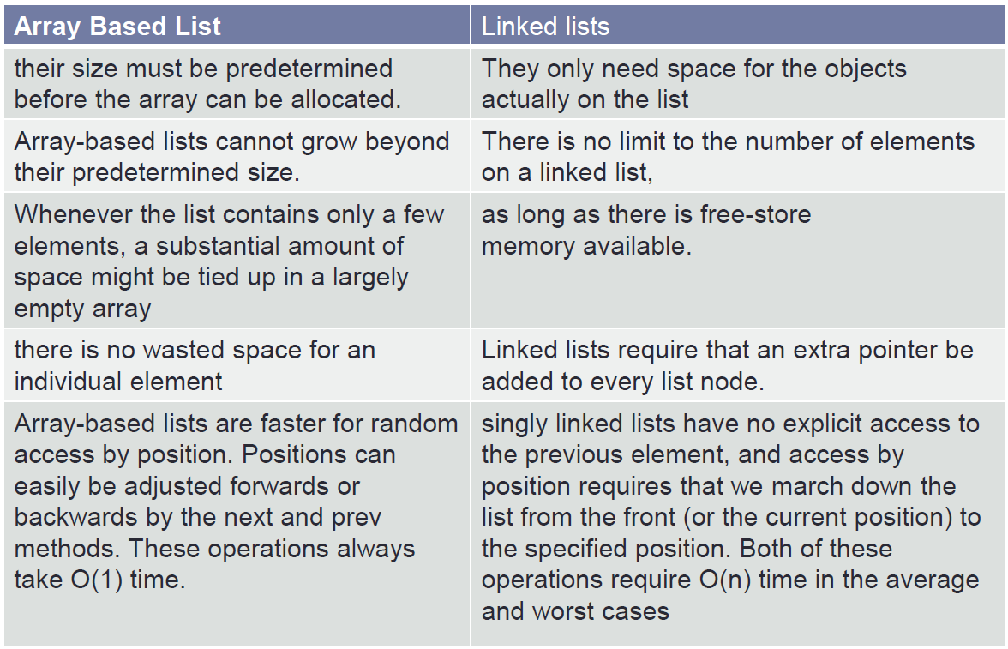
Comparison of List Implementations

Slide 10
Linked List
Advantages
Data easily inserted and deleted
No need to shift elements of LL to make room for a new element or to delete an element
Disadvantages
We are limited to a sequential search

Slide 11
Circularly Linked Lists
Many applications in which data can be more naturally viewed as having a cyclic order with well-defined neighboring relationships, but no fixed beginning or end
Multiplayer games
City buses
Operating system

Slide 12
Round-robin scheduling
A process is given a short turn to execute, known as a time slice
The slice ends and the job is complete.
The slice ends and the job is not yet complete.
A traditional linked list, by repeatedly performing the following steps on linked list L
1. process p = L.removeFirst( )
2. Give a time slice to process p
3. L.addLast(p)

Slide 13
Round-robin scheduling
Drawbacks to the use of a traditional linked list
Inefficient to remove a node from one end of the list and then create a new node for the same element.
Decrement and increment the list’s size
Unlink and relink nodes
Can we build a more efficient data structure for representing a cyclic order
A modification to our singly linked list implementation

Slide 14
Circularly linked list
A singularly linked list in which the next reference of the tail node is set to refer back to the head of the list (rather than null)

Slide 15
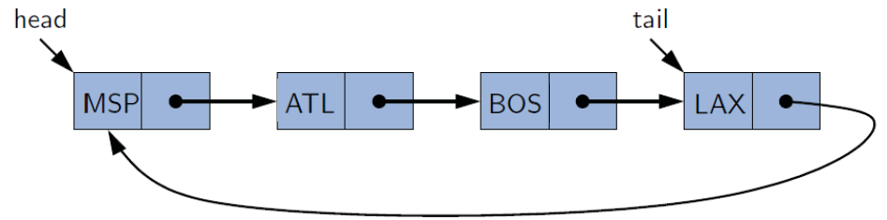
Circularly linked list
Supports all the public methods of our SinglyLinkedListclass
One additional update method rotate( )
Moves the first element to the end of the list.

Slide 16
CircularlyLinkedList class
Round-robin scheduling can be efficiently implemented by repeatedly performing the following steps on a circularly linked list C
Give a time slice to process C.first( )
C.rotate( )
Additional optimization
We no longer explicitly maintain the head reference
We can locate the head as tail.getNext( )
Notes:
Maintaining only the tail reference not only saves a bit on memory usage, it makes the code simpler and more efficient, as it removes the need to perform additional operations to keep a head reference current

Slide 17
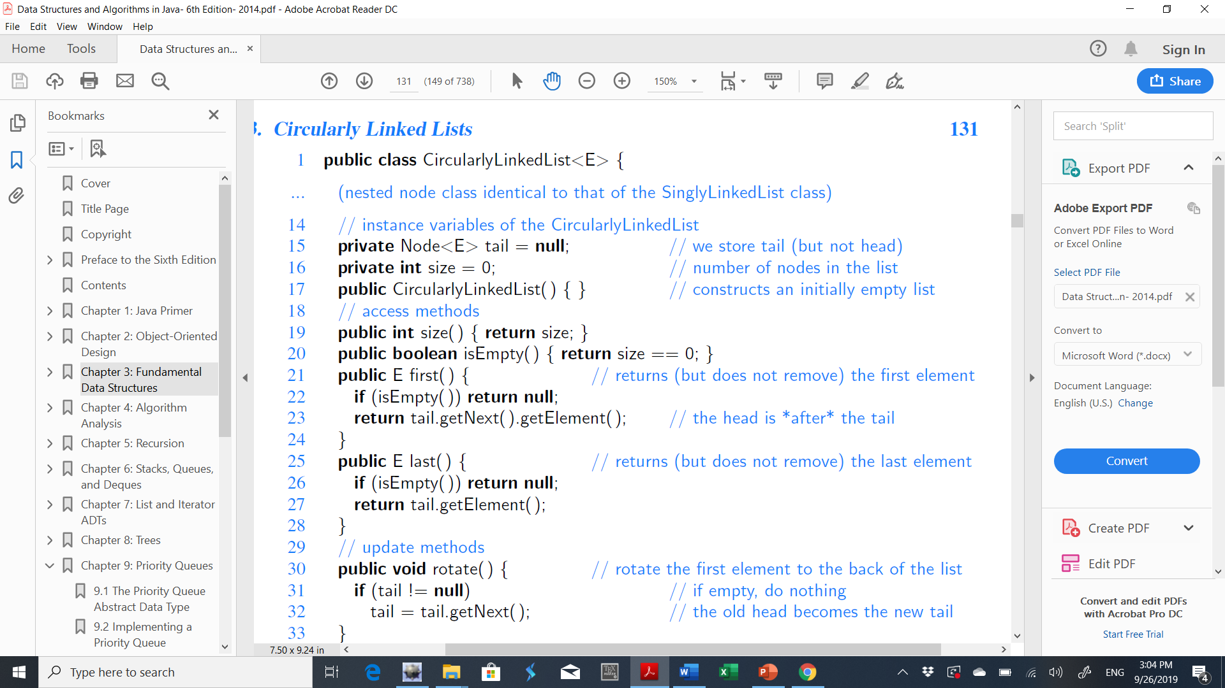
CircularlyLinkedList

Slide 18
CircularlyLinkedList

Slide 19
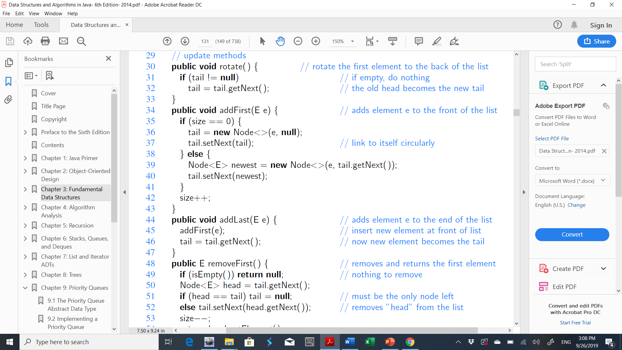
CircularlyLinkedList
tail
X
Y
Z
tail
Y
Z
X

Slide 20
CircularlyLinkedList (addFirst)
Empty list:
tail
A

Slide 21
CircularlyLinkedList (addFirst)
Nonempty list:
tail
X
Y
Z
newest

Slide 22
CircularlyLinkedList (addFirst)
Nonempty list:
tail
A
X
Y
Z
newest

Slide 23
CircularlyLinkedList (addFirst)
Nonempty list:
tail
A
X
Y
Z
newest

Slide 24
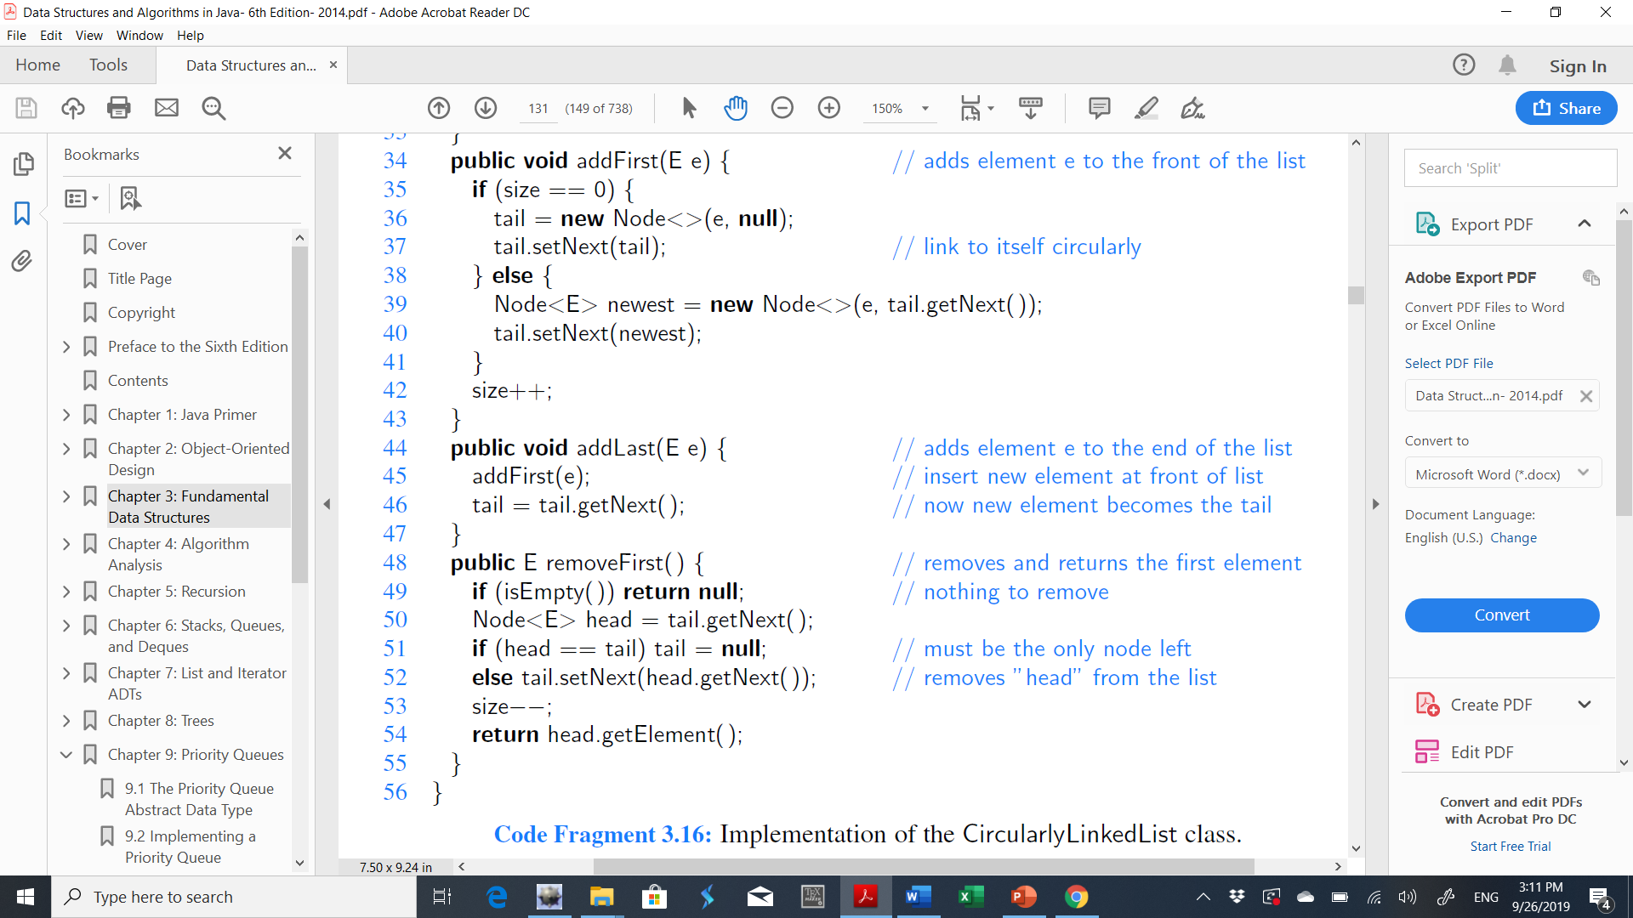
CircularlyLinkedList (addLast)
tail
X
Y
Z
tail
A
X
Y
Z
tail
A
X
Y
Z
tail
X
Y
Z
A

Slide 25
CircularlyLinkedList (removeFirst)
Empty list:
tail

Slide 26
CircularlyLinkedList (removeFirst)
List with only one node:
head
tail
A

Slide 27
CircularlyLinkedList (removeFirst)
List with only one node:
head
tail
A

Slide 28
CircularlyLinkedList (removeFirst)
List with more than one node:
head
tail
X
Y
Z

Slide 29
CircularlyLinkedList (removeFirst)
List with more than one node:
head
tail
X
Y
Z

Slide 30
Exercise
Describe a method for finding the middle node of a doubly linked list with header and trailer sentinels by “link hopping,” and without relying on explicit knowledge of the size of the list. In the case of an even number of nodes, report the node slightly left of center as the “middle.” What is the running time of this method?

